Slide 1


Noura Alhuthali
5/6/2025

Slide 2

Outline
Executive Summary
Introduction
Methodology
Results
Conclusion
Appendix

Slide 3
Executive Summary
Methodologies Summary
Collected and cleaned launch data using Pandas
Preformed exploratory data analysis (EDA) with visual tools
Built interactive visuals using Folium and Plotly Dash
Used SQL to query launch data for key insights
Built a classification model to predict launch success
Results Summary
Most launches occurred at CCAFS LC-40
Higher success rates for payloads under 10,000 kg
Folium maps show site locations and outcomes
Predictive model identified key features affecting success

Slide 4
Introduction
SpaceX has conducted numerous rocket launches from various sites, each with different outcomes. This project aims to analyze launch performance and identify key factors influencing mission success. Using data science techniques such as EDA, mapping, and classification models, we explore which launch sites are most successful, how payload size and booster versions impact outcomes, and whether it's possible to predict launch success based on mission features.

Slide 5

Section 1

Slide 6
Methodology
This project investigates SpaceX launch records to uncover patterns and predict mission outcomes. The data was collected from publicly available SpaceX datasets and supplemented with geolocation information. After initial data wrangling to clean and prepare the dataset, we conducted exploratory data analysis (EDA) using visualizations and SQL queries to identify key trends. Interactive visual analytics were developed using Folium maps to visualize launch site locations and success, and a Plotly Dash dashboard to allow dynamic exploration of launch performance. For predictive analysis, we applied classification models to estimate launch success based on features such as payload mass and booster version. These models were built, tuned, and evaluated using accuracy metrics and performance comparison to select the best-performing model.

Slide 7
Data Collection
The dataset collected from the official SpaceX API and supplementary CSV file from the IBM course The main dataset included launch records with details such as launch site, payload mass, booster version, and mission outcome additional dataset was obtained to provide geographic coordinates (latitude and longitude) for each launch site. These files were downloaded directly using Python tools ensuring data was loaded into the workspace in real-time for analysis.
data collection process
Access SpaceX public dataset (CSV/API)
Retrieve launch records
Download geolocation dataset
Load dataset into python using pandas
Merge datasets

Slide 8
Data Collection – SpaceX API
Noura-DS/IBM_FINAL_PROJECT

Slide 9
Data Collection - Scraping
Noura-DS/IBM_FINAL_PROJECT

Slide 10
Data Wrangling
The cleaned dataset was imported, and missing values were checked, especially in the LaunchingPad column which contained nulls when no launchpad was used.
Data types were reviewed and included int64, float64, object, and bool.
Basic analysis was performed on columns like LaunchSite, showing that Cape Canaveral SLC 40 had the highest number of launches.
A new feature called class was created from the Outcome column, where any result containing "False" or "None" was marked as failed (0), and others as successful (1).
https://github.com/Noura-DS/IBM_FINAL_PROJECT

Slide 11
EDA with Data Visualization
I used Seaborn and Matplotlib to create visualizations that helped explore patterns in the data. One of the key charts was a scatter plot, which I used to visualize the relationship between Flight Number and Launch Site, along with other related features. I also created a bar chart to show the relationship between the success rate and each orbit type.
https://github.com/Noura-DS/IBM_FINAL_PROJECT

Slide 12
EDA with SQL
SELECT with WHERE and DISTINCT: Queried data for specific launch outcomes and Extracted unique values such as successful or failed landings.
GROUP BY with COUNT(): Counted the number of launches per site or per booster version.
ORDER BY and LIMIT: Restricted the number of rows returned and Sorted results.
JOINs: Merged data from different tables to analyze combined information like booster versions and landing outcomes.
Aggregation: Calculated average, maximum, or minimum payload mass or number of successful launches.
Filtering using LIKE: Filtered text patterns such as payloads containing "Starlink".
Subqueries: Used to filter or calculate values based on nested SELECT statements.
https://github.com/Noura-DS/IBM_FINAL_PROJECT

Slide 13
Build an Interactive Map with Folium
Map Objects Added:
Base Map: Centered around the average coordinates of SpaceX launch sites.
Markers: Placed at each launch site with popups showing site name and launch success stats.
Circles: Colored by success rate (e.g., green for high, red for low) to highlight performance visually.
Circle Markers: Represented individual launches; color-coded by success/failure.
Popups: Displayed additional data like payload mass, orbit, and outcome on click.
Layer Control: Enabled toggling between launch sites and individual launches for better interactivity.
We add this because we want to to give users a geographic overview of all SpaceX launch sites and make the map interactive and informative with minimal clutter.
https://github.com/Noura-DS/IBM_FINAL_PROJECT

Slide 14
Build a Dashboard with Plotly Dash
Pie Chart: Shows the proportion of successful vs. failed launches.
Bar Chart: Displays the number of launches per site with filters by success outcome.
Scatter Plot: Visualizes correlation between payload mass and launch success, color-coded by booster version.
Dropdown Menus: Allow users to select a launch site or filter by payload range.
Range Slider: Lets users filter data by payload mass range dynamically.
These where added to allow users to explore launch performance from different angles and support interactive analysis making insights visually accessible for technical and non-technical stakeholders.
https://github.com/Noura-DS/IBM_FINAL_PROJECT

Slide 15
Predictive Analysis (Classification)
Model Development Process
Data Preprocessing
Cleaned data (missing values, outliers)
Standardized and normalized features
Model Selection
Tried several classification models such as Logistic Regression, Decision Trees, Random Forest, and Support Vector Machines (SVM)
Used GridSearchCV for hyperparameter tuning
Model Training
Split data into training and testing sets (80% training, 20% testing)
Trained multiple models on the training set
Model Evaluation
Used evaluation metrics such as accuracy, precision, recall, F1 score, and ROC-AUC
Compared model performance to select the best-performing model
Model Improvement
Fine-tuned the best model using cross-validation and optimized hyperparameters
Implemented feature engineering to improve model accuracy

Slide 16
Results
The classification models were trained and evaluated using a train-test split approach. GridSearchCV was used to find the optimal hyperparameters for each model. After comparing the performance of several classifiers, the DecisionTreeClassifier achieved the best results with a training accuracy of 88.9% and a test accuracy of 94%, along with an F1-score of 88.21%. This model was selected as the final model due to its strong balance between accuracy and interpretability, making it a suitable choice for further analysis or deployment.

Slide 17

Section 2

Slide 18
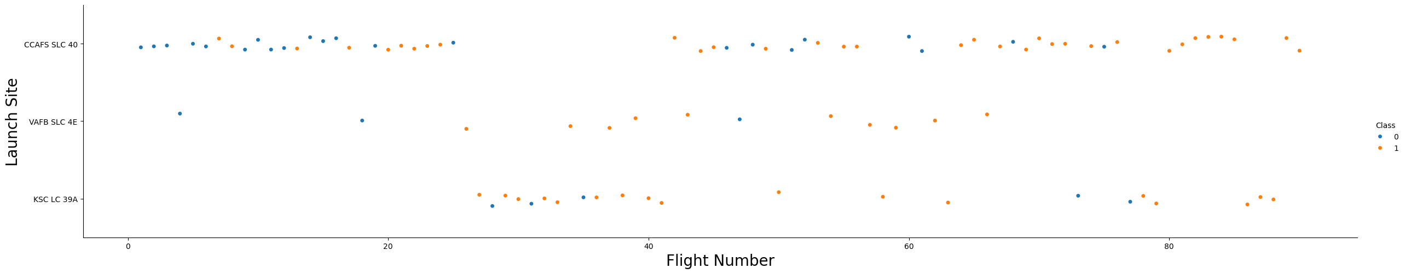
Flight Number vs. Launch Site
The plot shows that launch sites with a higher number of flights tend to have higher success rates. For example, CCAFS SLC 40 shows more successes as the flight number increases, while VAFB SLC 4E has fewer successful launches at higher flight numbers.

Slide 19
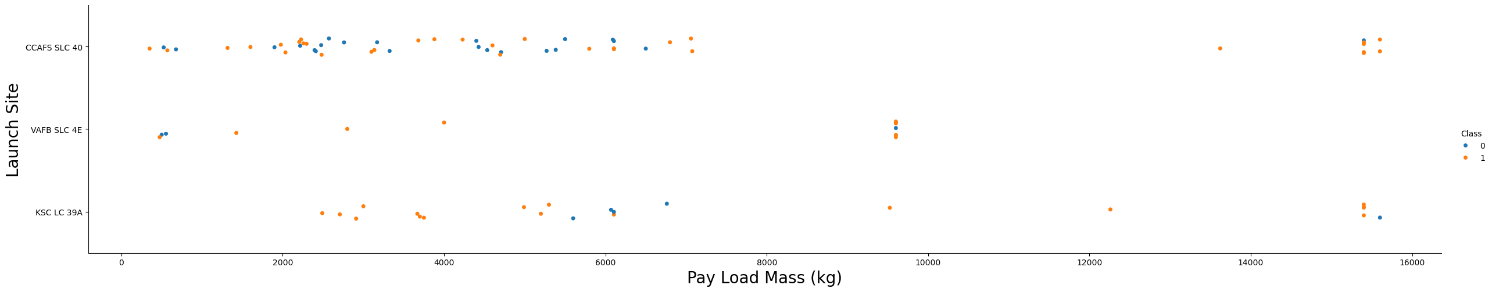
Payload vs. Launch Site
The plot shows that as the flight number increases, the success rate improves, especially for CCAFS SLC 40. In early flights, this site had more failures, but later flights show more consistent success. Also, higher payload mass at CCAFS SLC 40 is associated with a higher success rate.

Slide 20
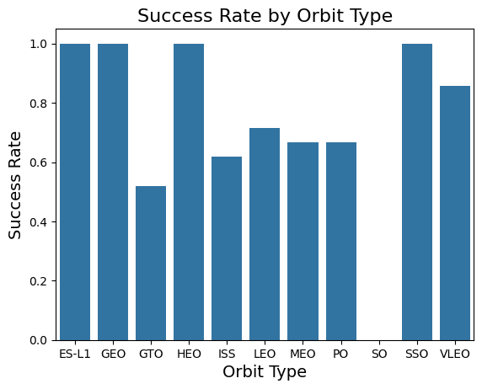
Success Rate vs. Orbit Type
From the plot, we observed that four orbit types ES-L1, SSO, HEO, and GEO achieved a 100% success rate these orbits showed the most consistent successful launches compared to others.

Slide 21
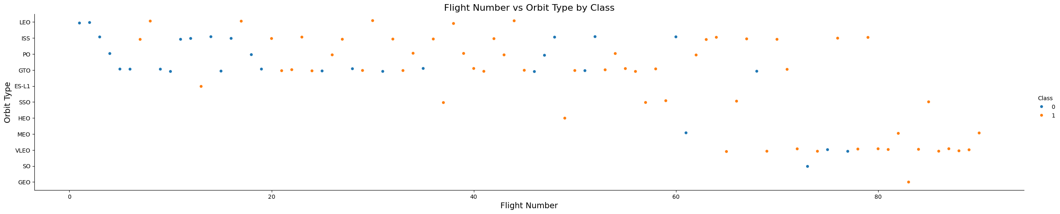
Flight Number vs. Orbit Type
From the plot, we can see that in the LEO and VLEO orbits, the success rate increases with higher flight numbers — especially after flight 60 for VLEO. However, in the GTO orbit, there is no clear relationship between flight number and success rate.

Slide 22
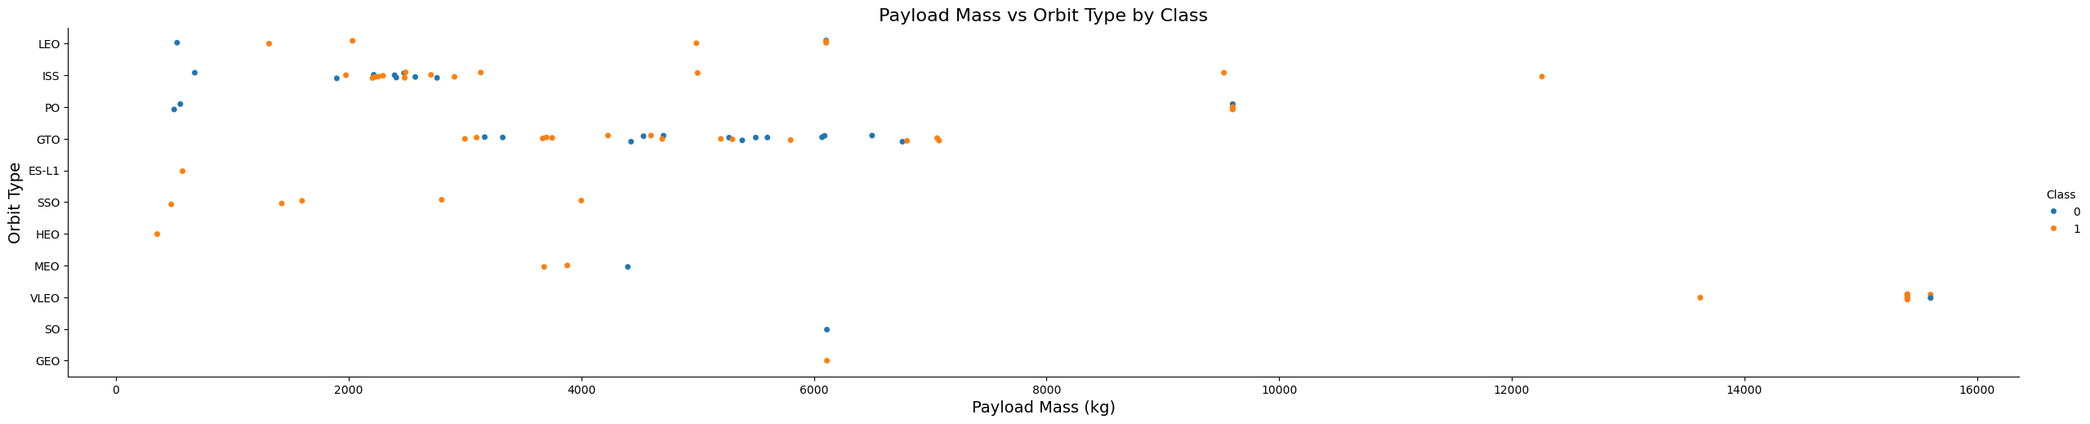
Payload vs. Orbit Type
The plot shows that heavier payloads are associated with more successful landings in the Polar, LEO, and ISS orbits. However, in the GTO orbit, both successful and unsuccessful landings are observed, indicating no clear trend for landing success with heavy payloads.

Slide 23
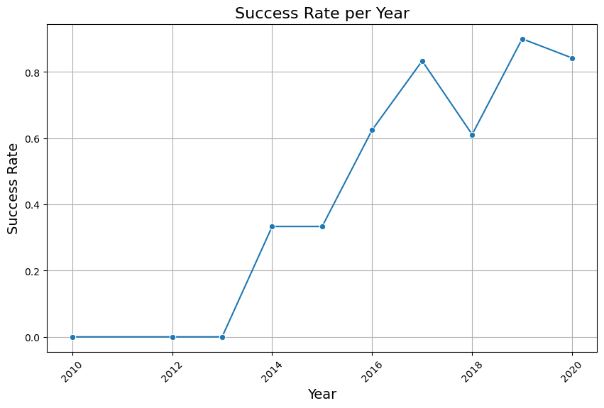
Launch Success Yearly Trend
The plot shows that the yearly success rate of Falcon 9 landings has been steadily increasing since 2013 and continued to rise through 2020.

Slide 24
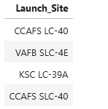
All Launch Site Names
We use DISTINCT to show only unique launch sites

Slide 25
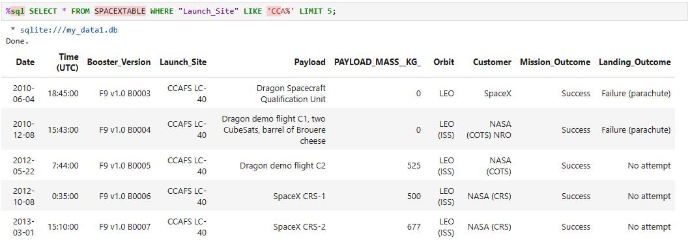
Launch Site Names Begin with 'CCA'

Slide 26
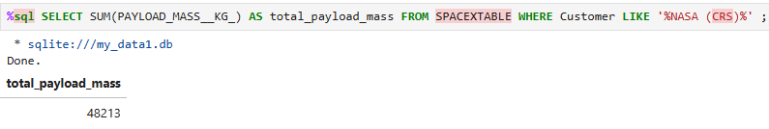
Total Payload Mass

Slide 27
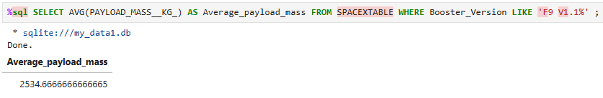
Average Payload Mass by F9 v1.1

Slide 28
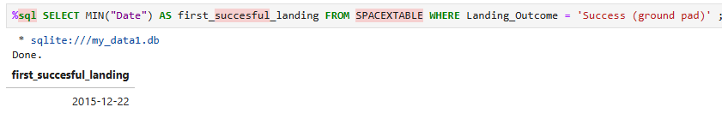
First Successful Ground Landing Date

Slide 29
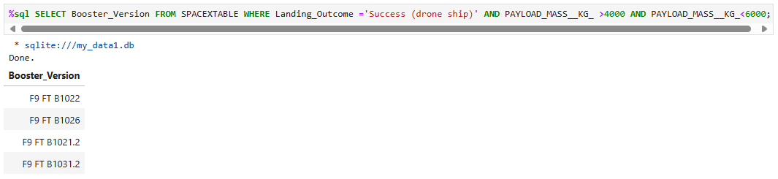
Successful Drone Ship Landing with Payload between 4000 and 6000

Slide 30
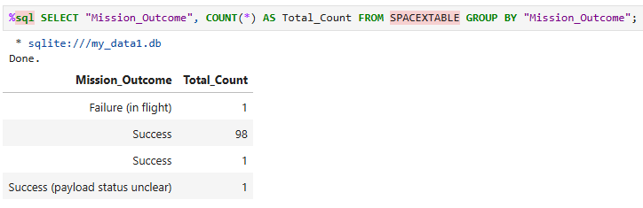
Total Number of Successful and Failure Mission Outcomes

Slide 31
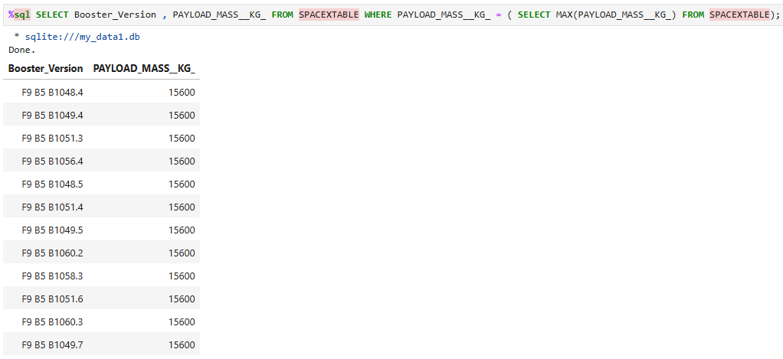
Boosters Carried Maximum Payload

Slide 32
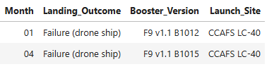
2015 Launch Records

Slide 33
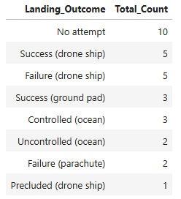
Rank Landing Outcomes Between 2010-06-04 and 2017-03-20

Slide 34

Section 3

Slide 35
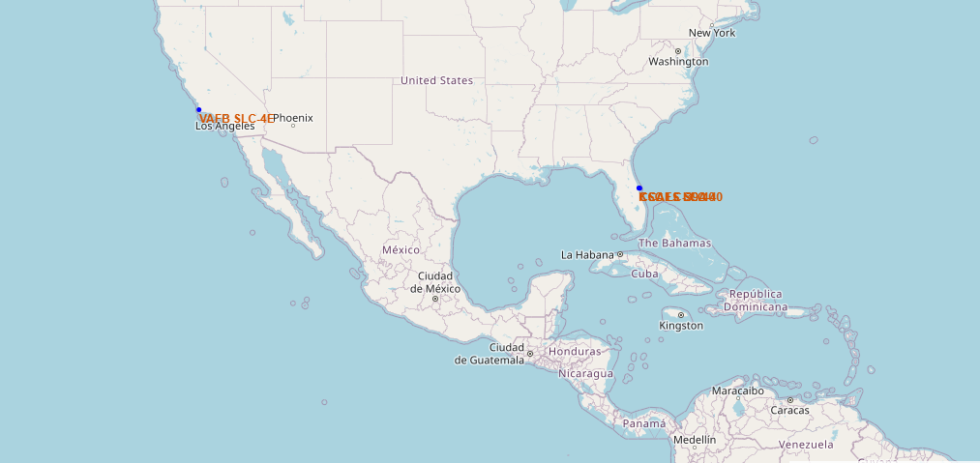
all launch sites on a map

Slide 36
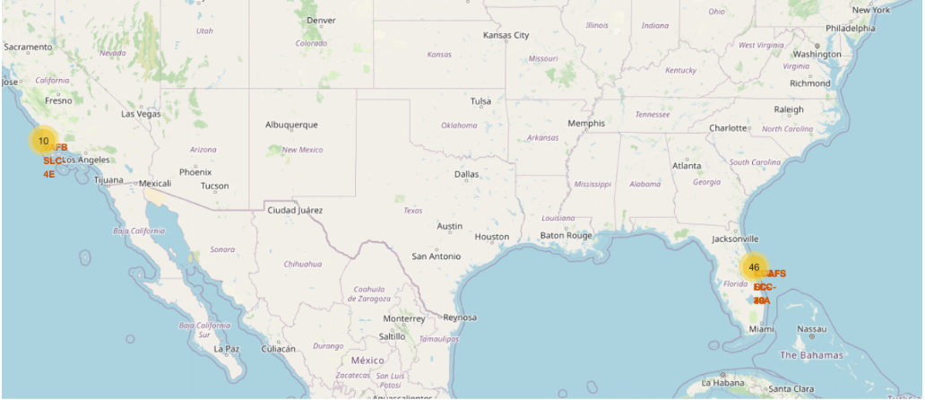
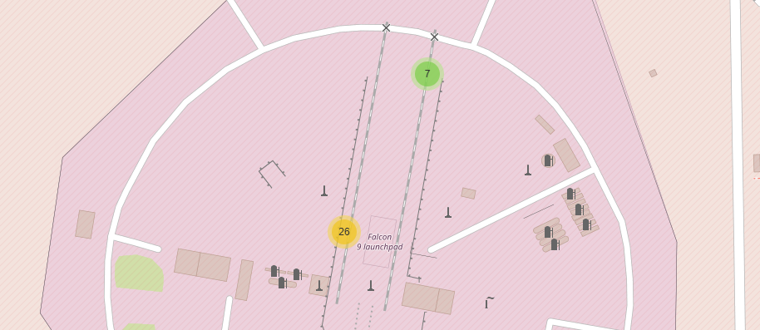
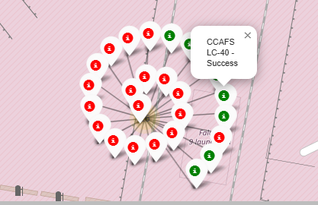
success/failed launches

Slide 37
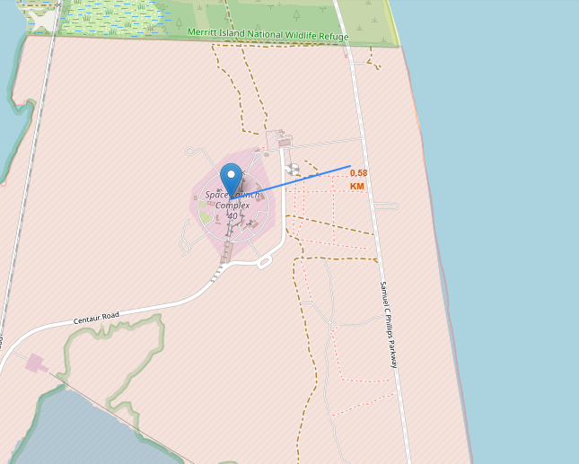
distances between a launch site

Slide 38

Section 4

Slide 39
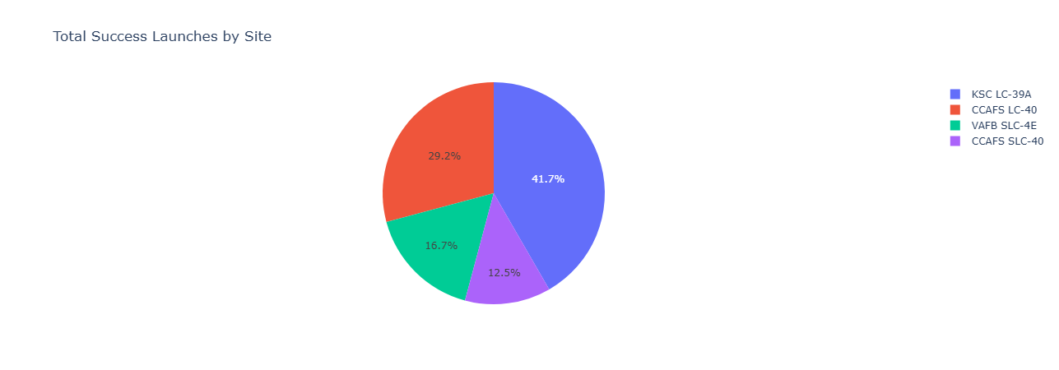
Total Success By All Sites

Slide 40
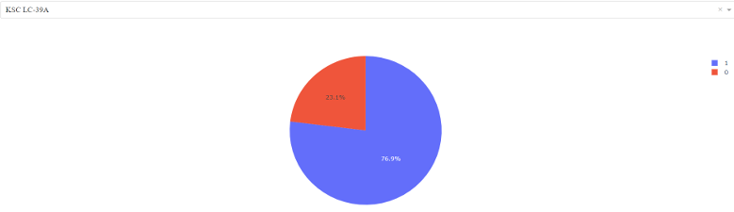
Pie chart for the launch site with highest launch success

Slide 41
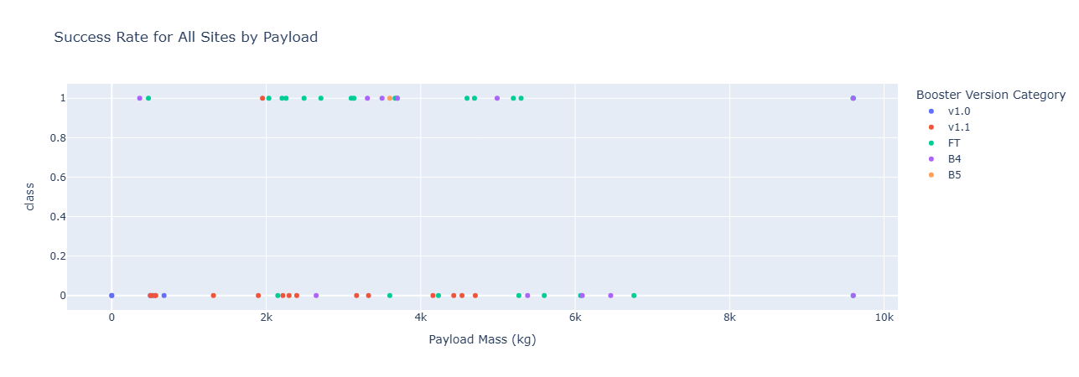
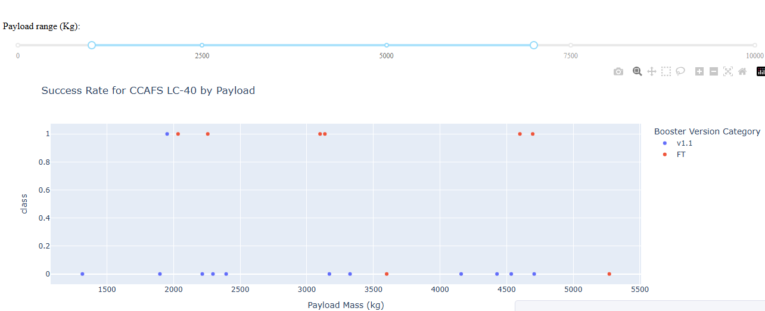
Launch Outcome for all sites, with different payload selected

Slide 42

Section 5

Slide 43
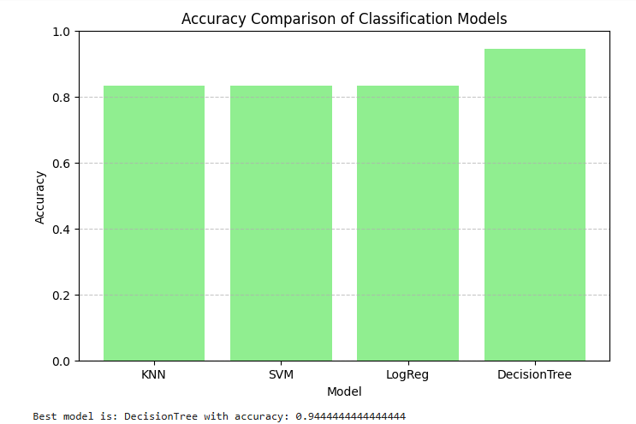
Classification Accuracy

Slide 44
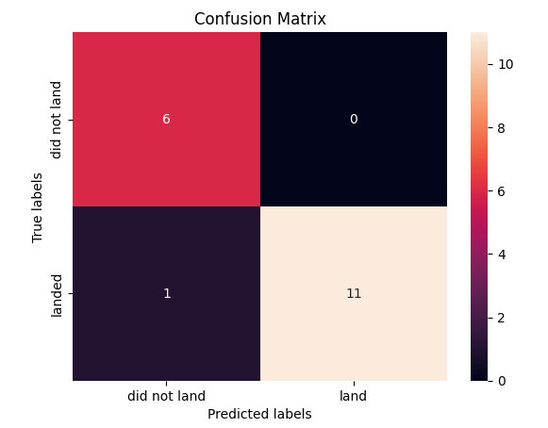
Confusion Matrix
This confusion matrix is for a Decision Tree model predicted 17 out of 18 cases correctly.
• It got 94% accuracy.
• 6 correct “did not land”
• 11 correct “landed”
• 1 wrong “did not land” (it actually landed)
• No false “landed” predictions.

Slide 45
Conclusions
Launch success rates have steadily increased from 2010 to 2020, with a notable rise starting in 2013.
Launch sites with a higher number of flights, such as CCAFS SLC 40 and KSC LC-39A, showed greater success rates.
Orbits like ES-L1, SSO, GEO, and HEO had a 100% landing success rate, making them the most reliable.
There is a positive correlation between payload mass and launch success.
Among all the classification models tested, the Decision Tree Classifier performed best with a training accuracy of 88.9% and a test accuracy of 94%.
This high accuracy demonstrates the model’s effectiveness in predicting Falcon 9 landing outcomes, supporting better mission planning in the future.

Slide 46
Appendix
All relevant assets included in this presentation can be found GitHub
https://github.com/Noura-DS/IBM_FINAL_PROJECT

Slide 47


